Slide 1
Earwig Parents - Guidance

Slide 2
Earwig - Introduction
What is it?
Ickburgh School uses EARWIG Academic which is an online platform that holds an individual timeline for each pupil in our school by displaying their learning journey through a range of photographs and videos of their learning.
Each EARWIG video record contains a commentary by a member of the school team, presented in the form of a continuous timeline covering the pupil’s journey through the school by celebrating pupil achievement against relevant assessment frameworks.
How does it work?
Parents/Carers are provided with a secure login, so that they can see new records as they are made. These timelines lead to more interesting and relevant conversations at home about what your child is doing at school and parents are able to add comments to each record which will be seen by the teacher. Parents are notified when there are new records in their child’s timeline through an email alert. This gives parents almost real-time access to see what their children are doing at school that day. Parents/Carers can also add records of their own, to share achievements and progress at home. If you cannot access your child’s account please contact the school office and we will resolve this for you.
How much will it cost me?
EARWIG FOR PARENTS IS FREE - Access to the pupil timelines, including images and video, is free to parents while your child is at that school. You can also download images to your heart's content.
There is an option to acquire hi-res pictures for printing or to download videos. You can purchase these from your picture gallery - or, for an annual subscription, download as many as you want. However, this isn't necessary for you and your young person to have the full benefit of Earwig.

Slide 3
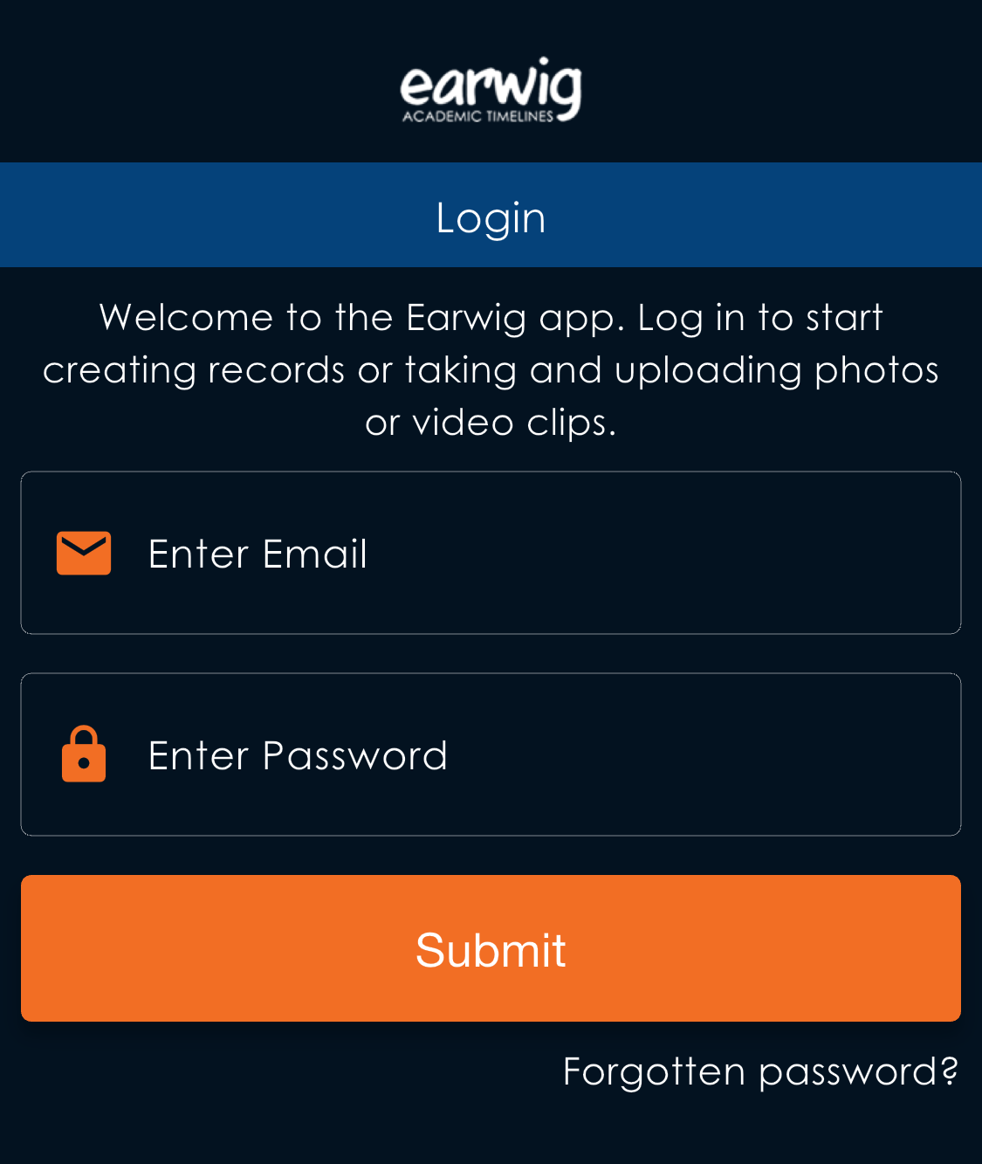
Earwig - APP
1. Earwig Parent is available to be downloaded free in your apple store and google play.
2. Log in by using your e-mail and given password.

Slide 4
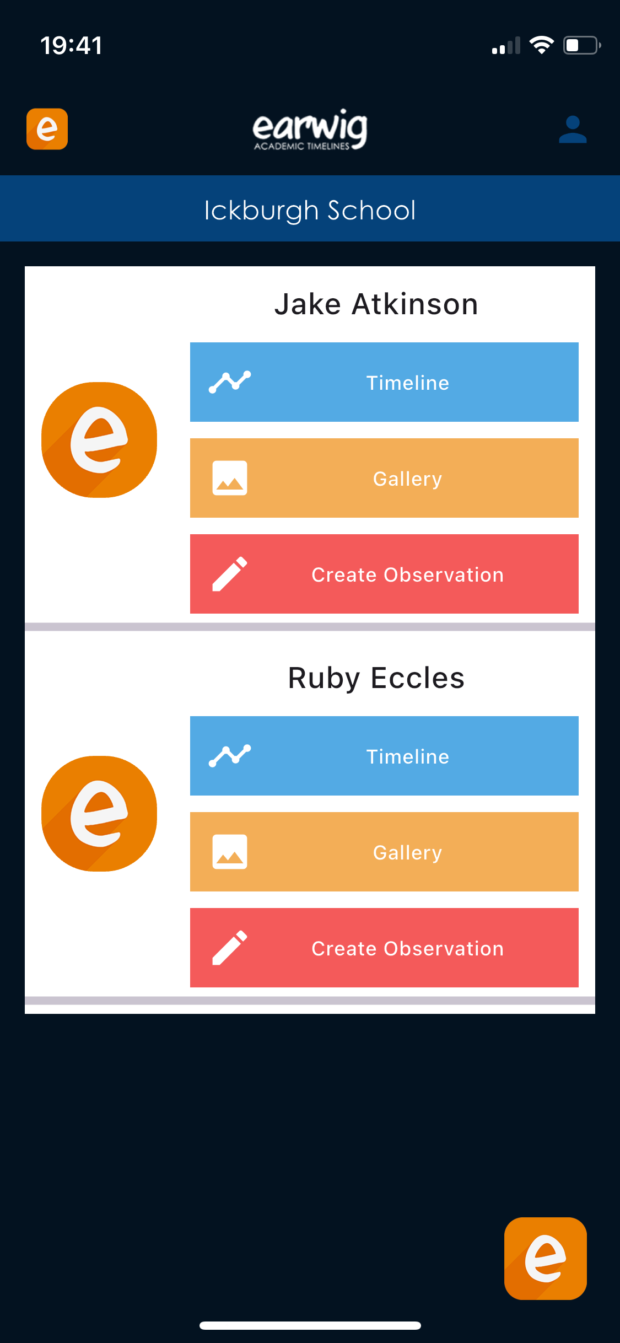
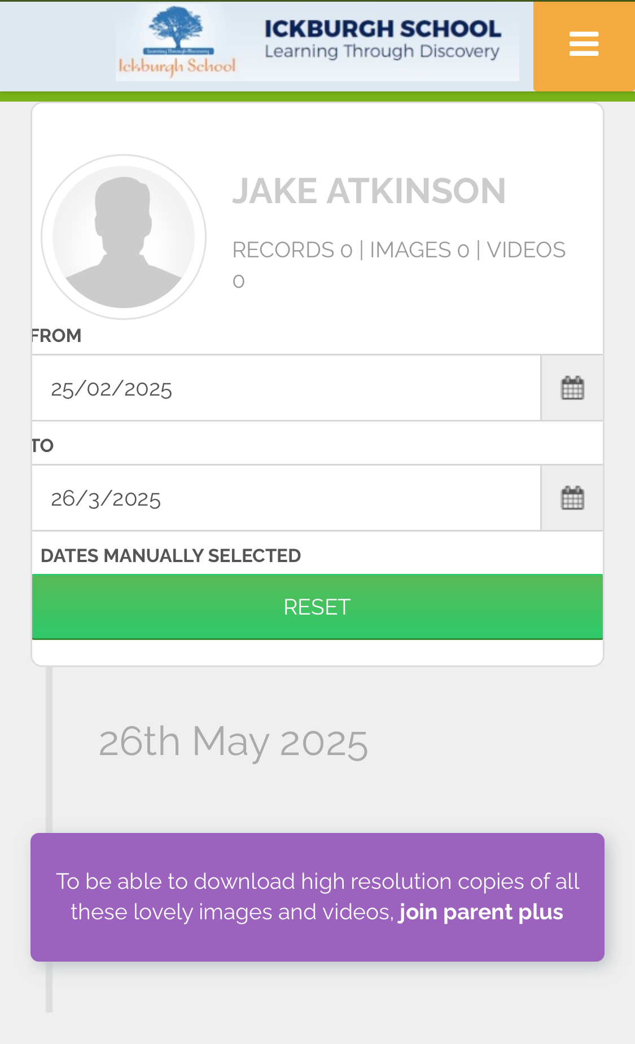
Earwig - APP
3. In the first page you will see the menus of your child or children.
To see their video records press Timeline
Timeline:
4. You might see your timeline empty, that's because the dates are not set properly.
Dates setting:
5. The dates MUST reflect:
From: first day of the term (or for full time line first day of school)
To: today's day

Slide 5
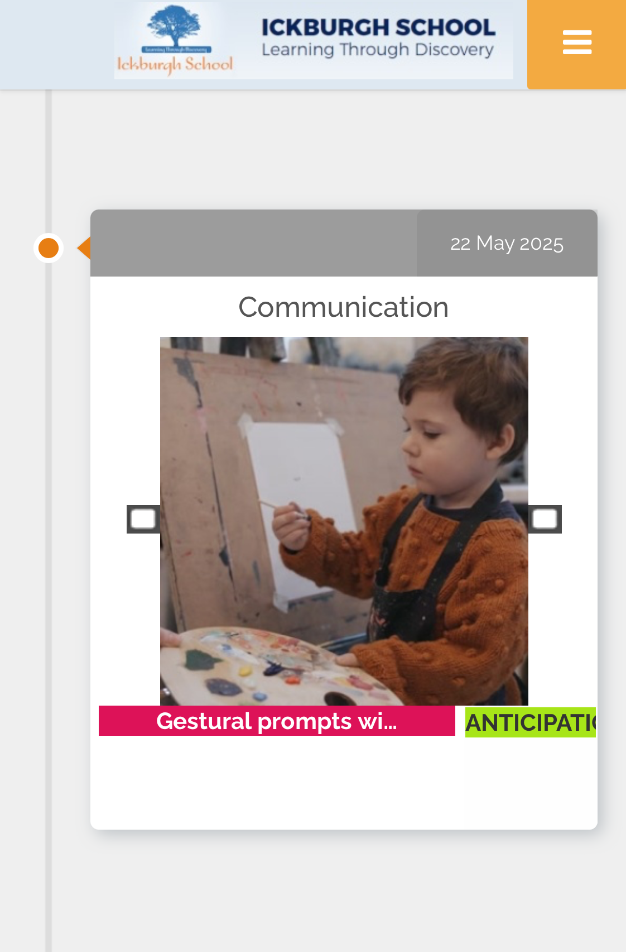
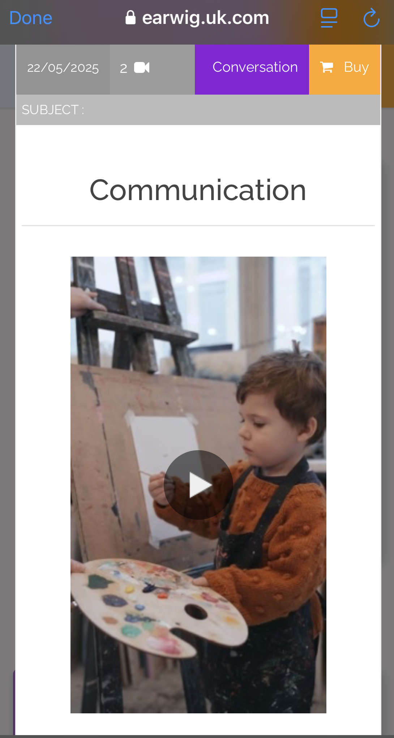
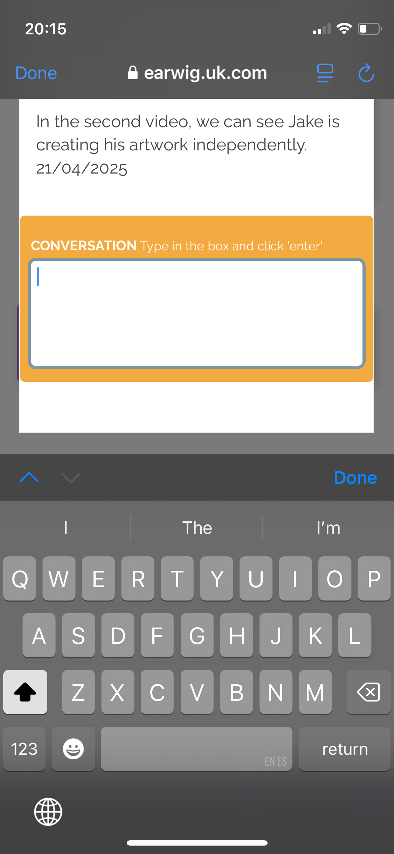
Earwig - APP
School Records
6. The records will appear in reverse chronological order.
School Records
7. You can play the videos and red the comments below.
Leave a comment:
8. You can leave a comment to be read by the class team by pressing "Conversation"

Slide 6
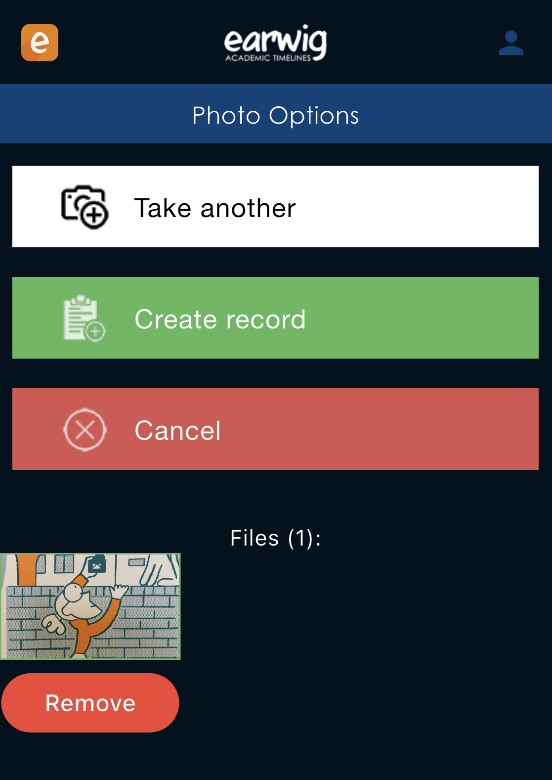
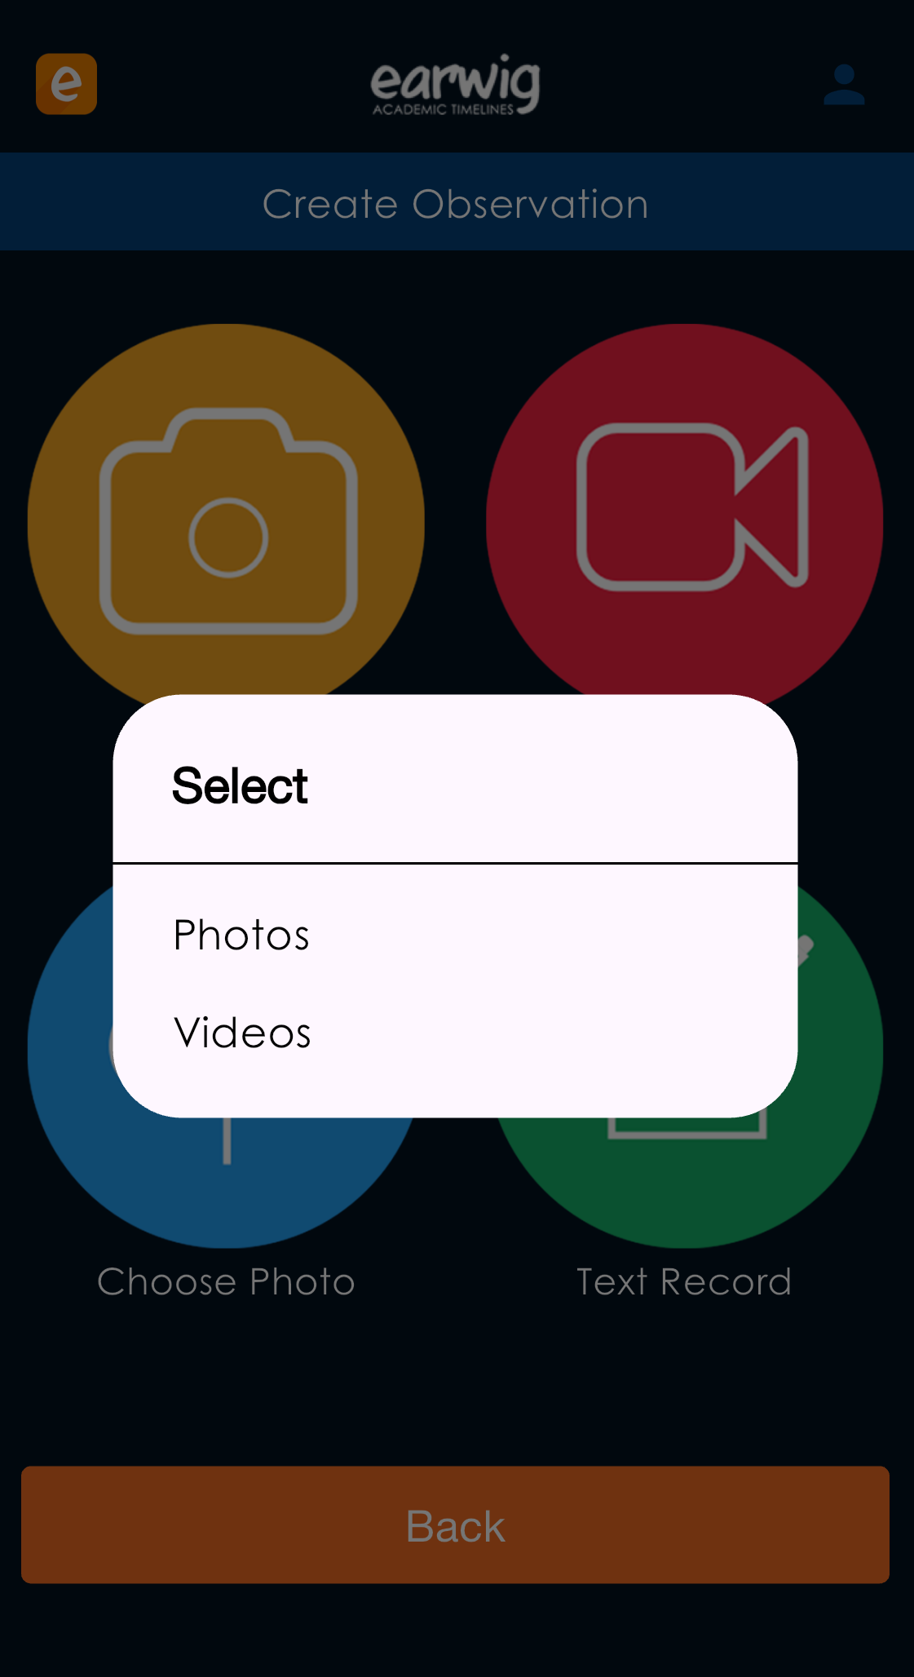
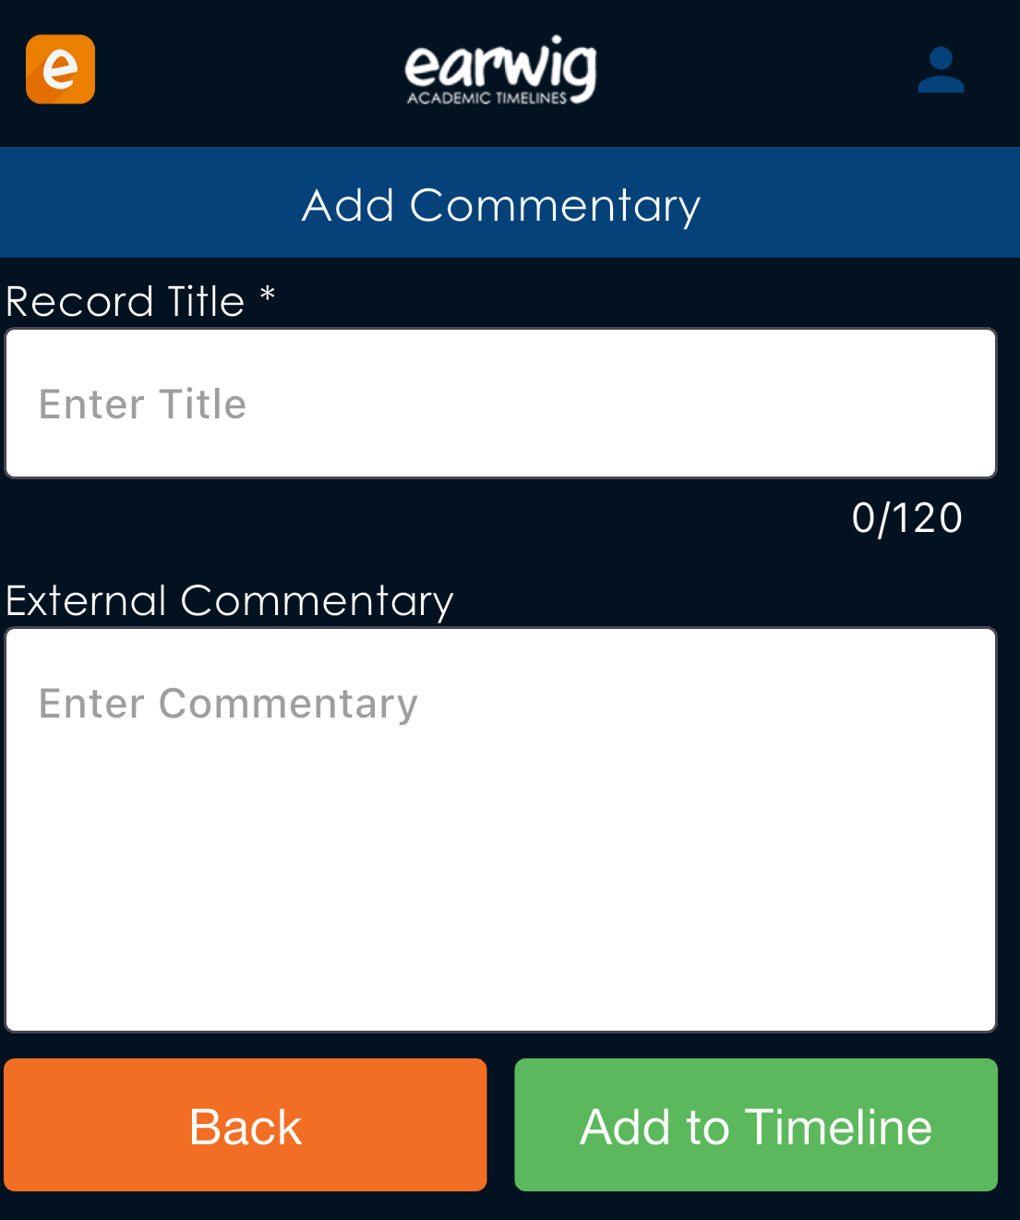
Earwig - APP
Home evidences:
9. You can create your own evidences to share with the class team by selecting "create observation"
Add photos/videos:
10. You can add a photo or video or record or take a photo to support your home evidence.
Create your home record
11.

Slide 7
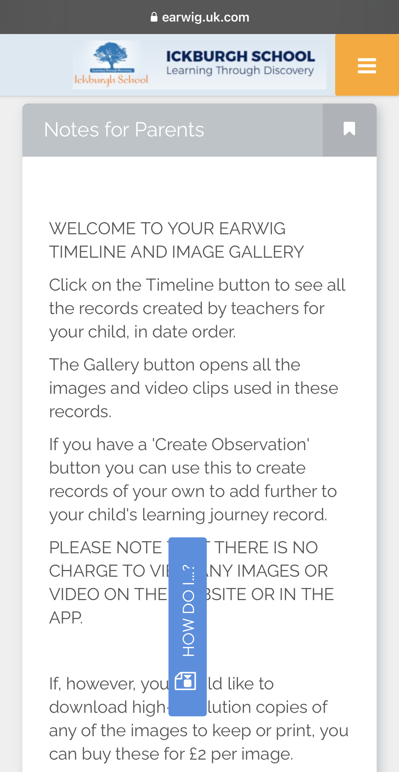
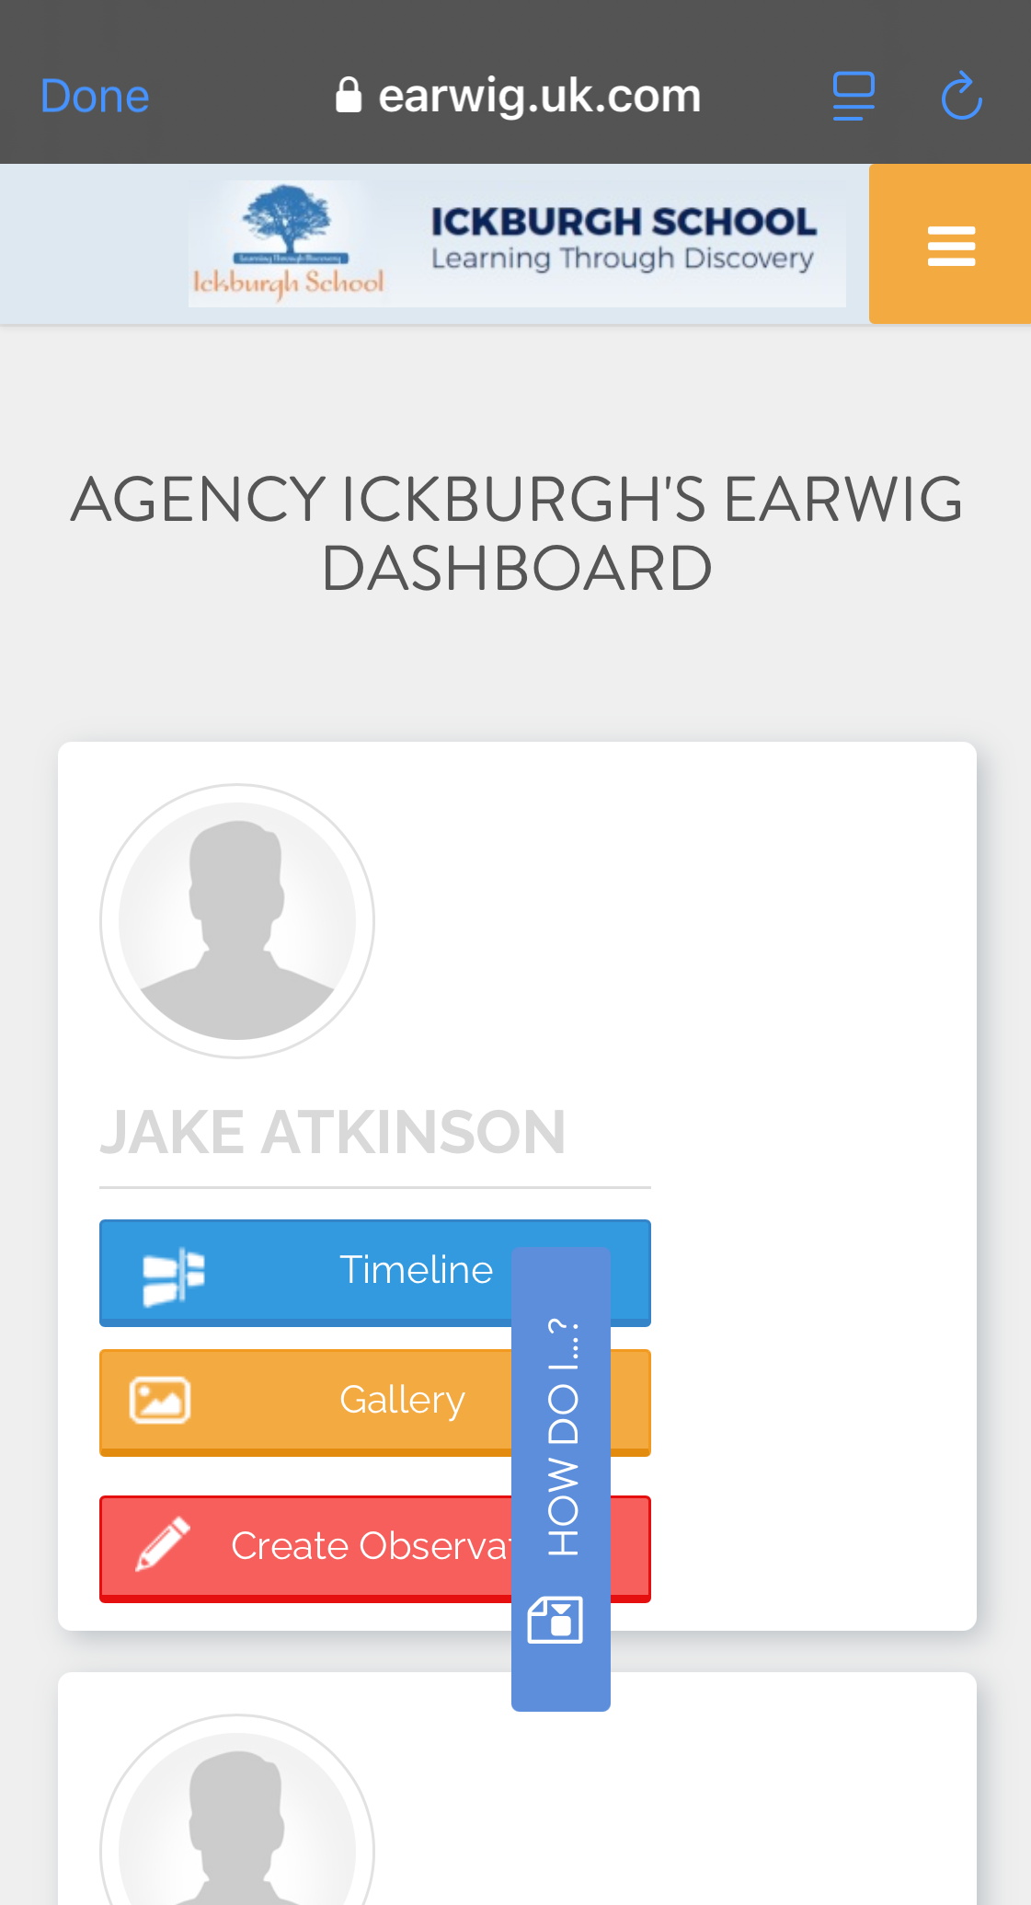
Earwig - APP
Earwig website:
12. By clicking on the orange icon you will access to Earwig website
Notes for parents:
Scroll down and you will see messages for parents from Earwig

Slide 8
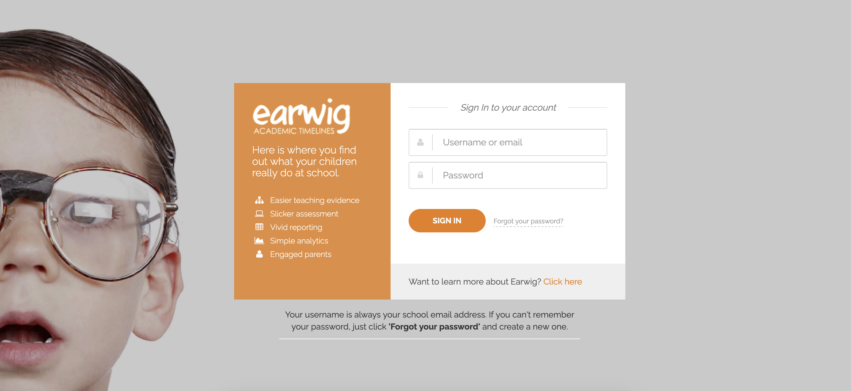
Earwig – website
https://earwig.uk.com/
1. Log in by using your e-mail and password given.

Slide 9
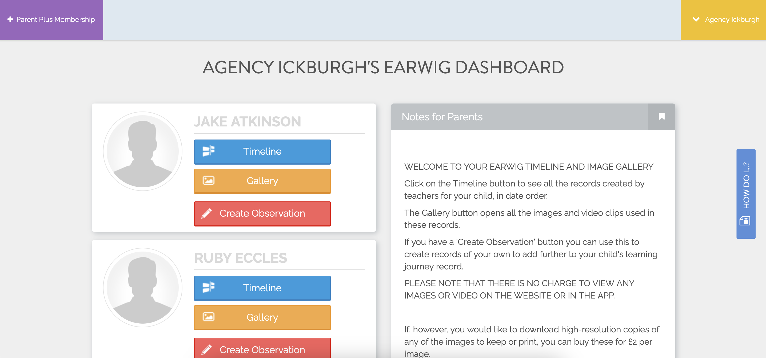
Earwig – website
2. You will see the menus of your child or children.
3. To see their video records press Timeline
Notes for parents:
4. On the right you will see messages for parents from Earwig

Slide 10
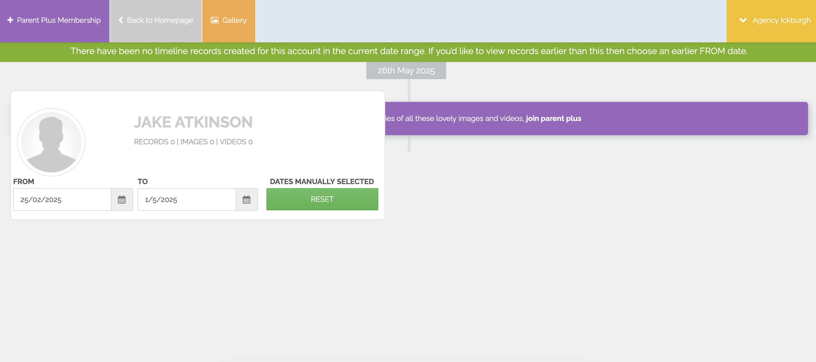
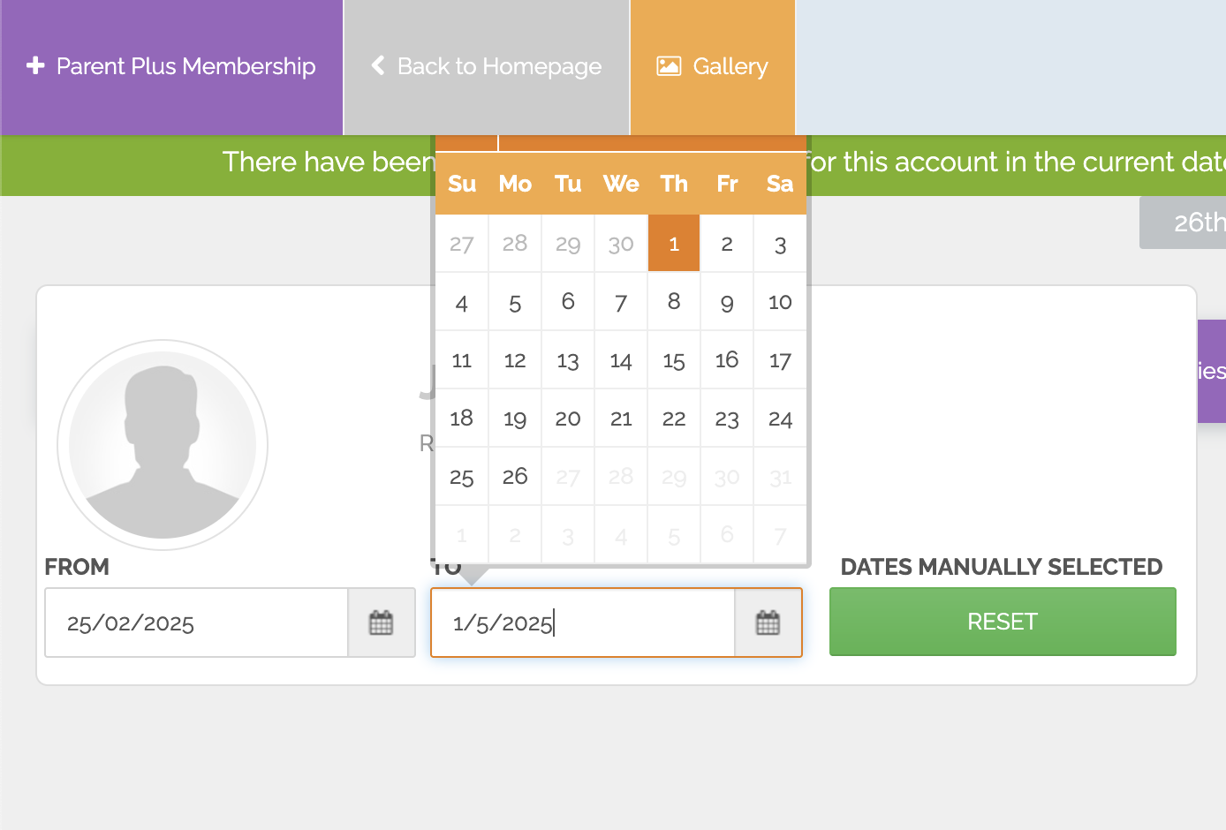
Earwig – website
Timeline:
5. You might see your timeline empty, that's because the dates are not set properly.
Dates setting:
6. The dates MUST reflect:
From: first day of the term (or for full time line first day of school)
To: today's day

Slide 11
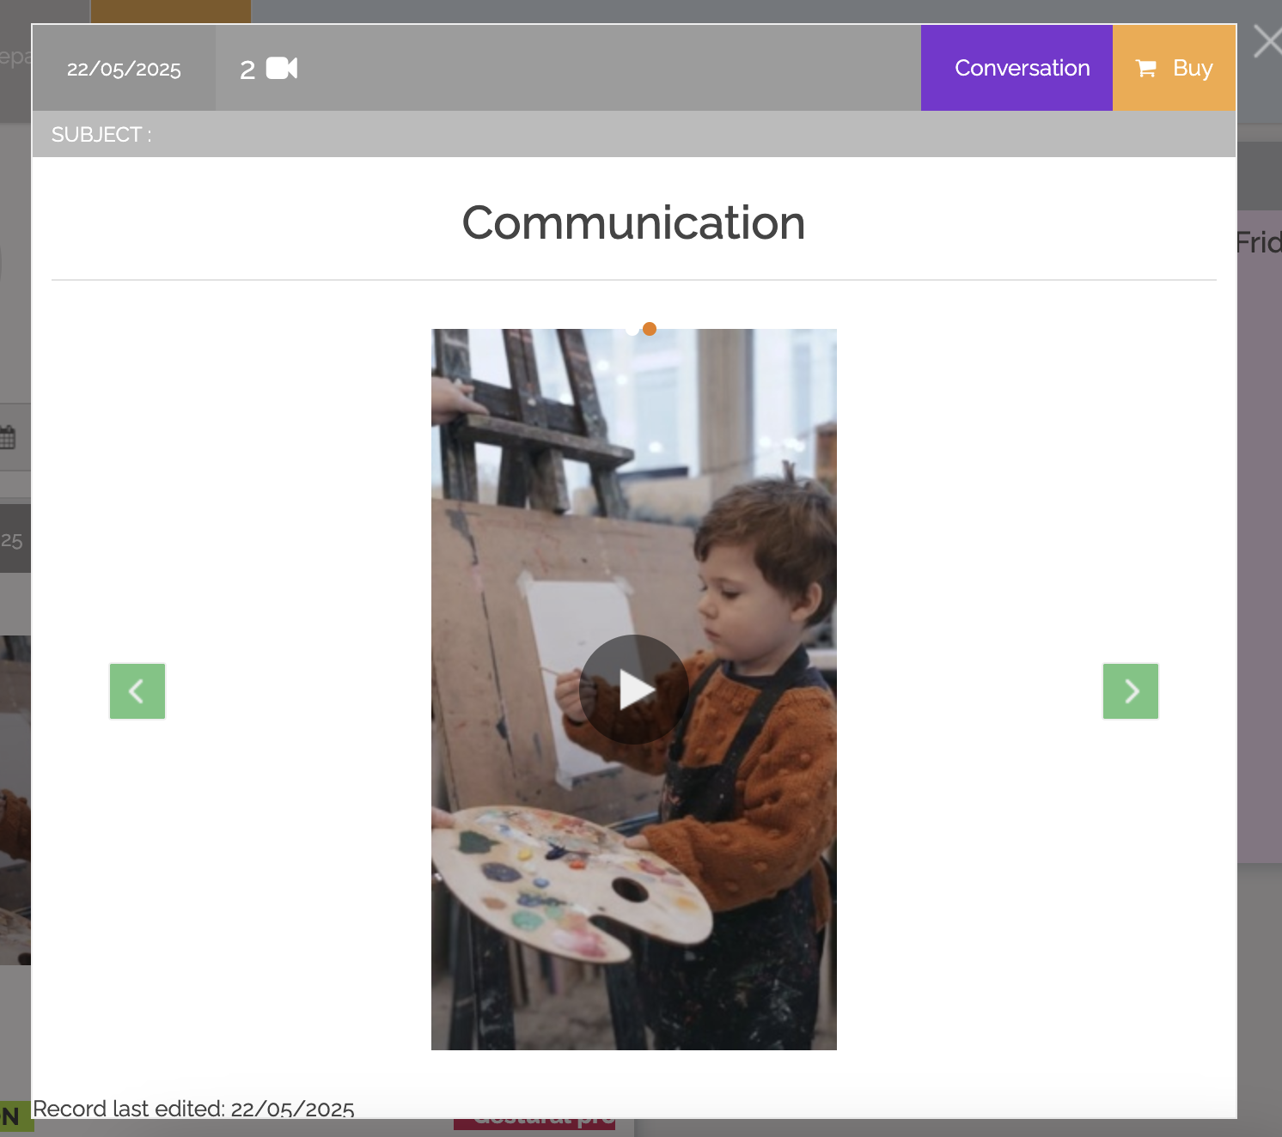
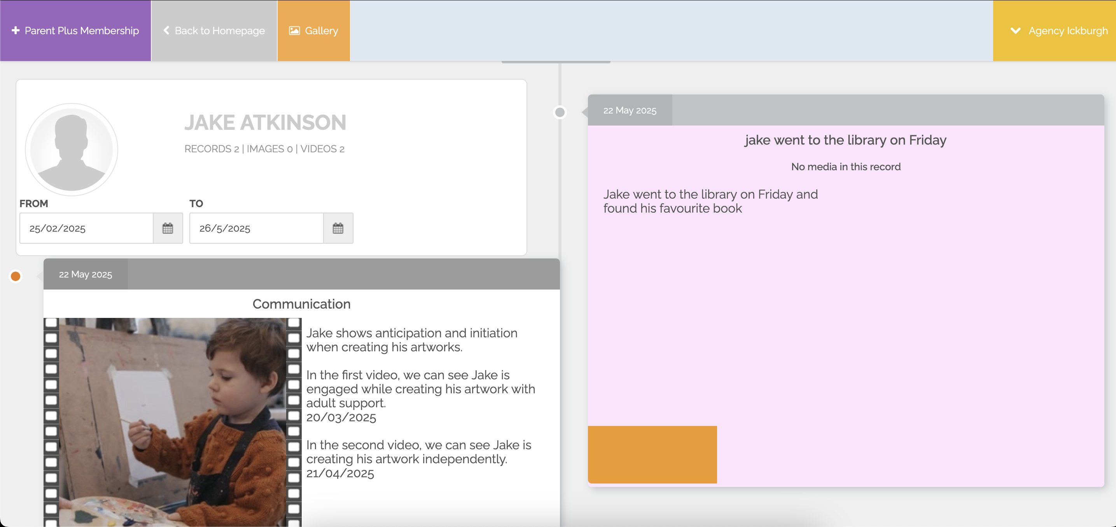
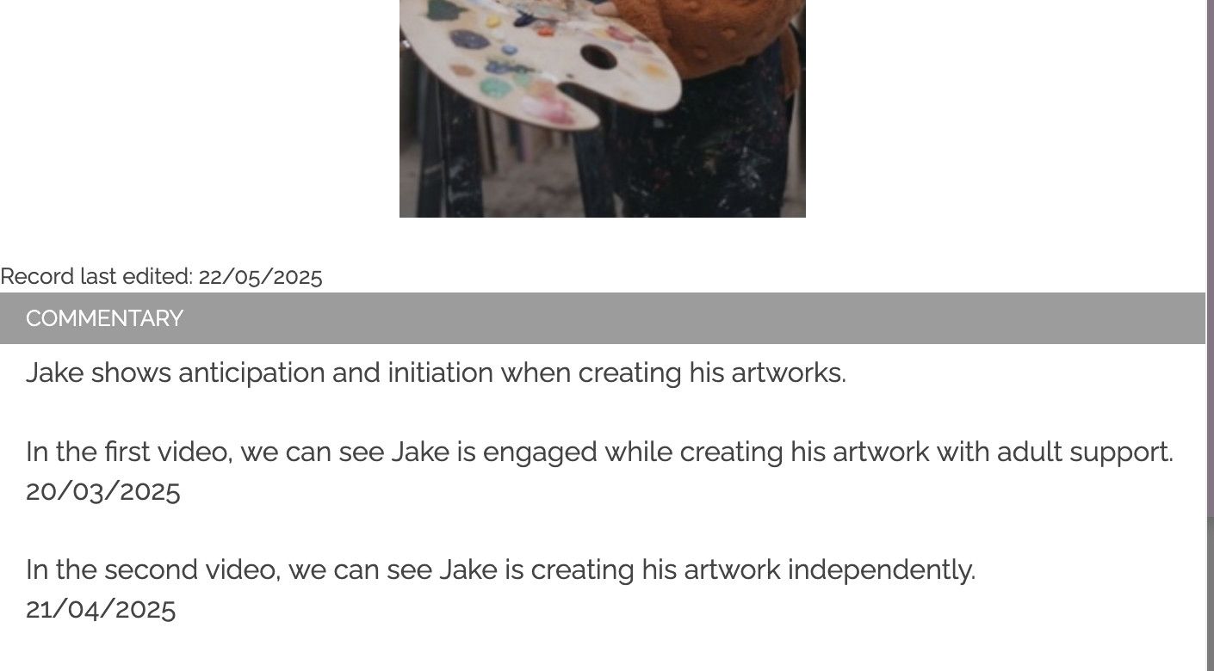
Earwig – website
School Records
7. The records will appear in reverse chronological order.
School Records​
8. You can play the videos and red the comments below.

Slide 12
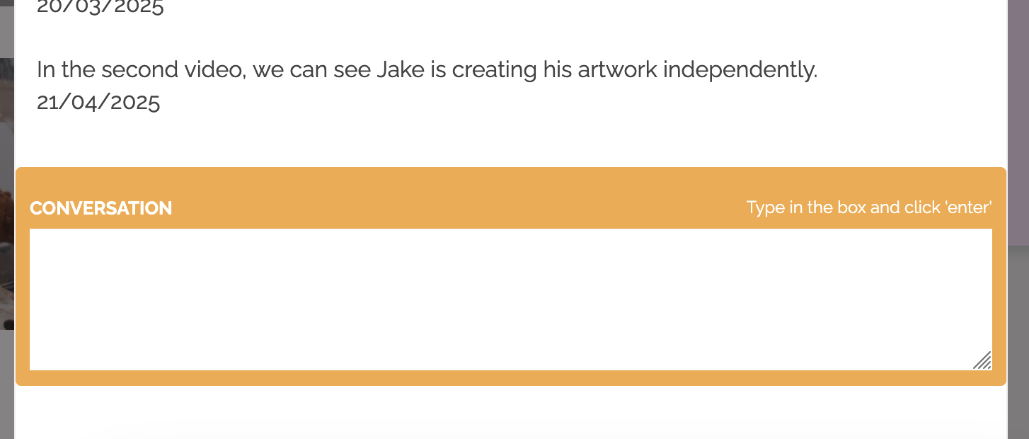
Earwig – website
Leave a comment:
9. You can leave a comment to be read by the class team by pressing "Conversation"
Back to homepage:
10. Click on Back to Homepage
Home evidences:
11. You can create your own evidences to share with the class team by selecting "create observation"

Slide 13
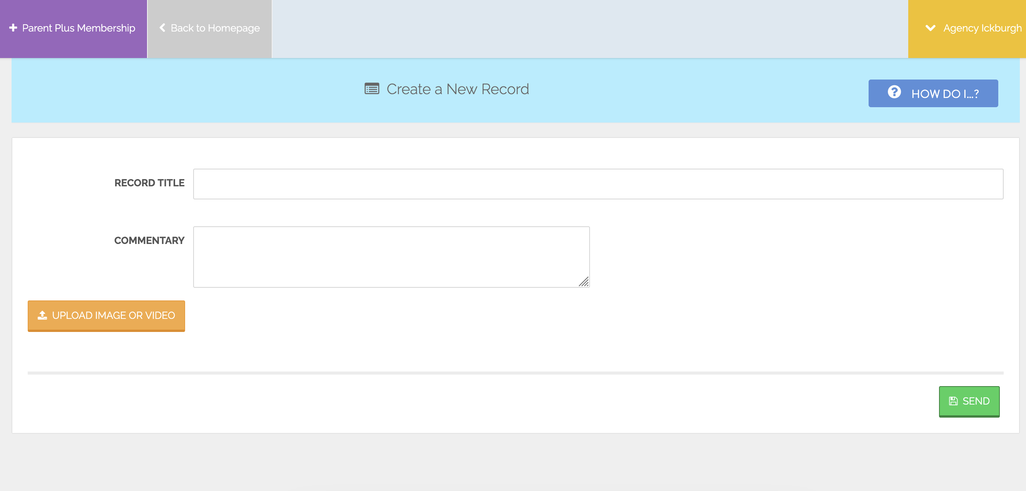
Earwig – website
Home Evidence
Add photos/videos:
12. You can add a photo or video or record or take a photo to support your home evidence.

Slide 14
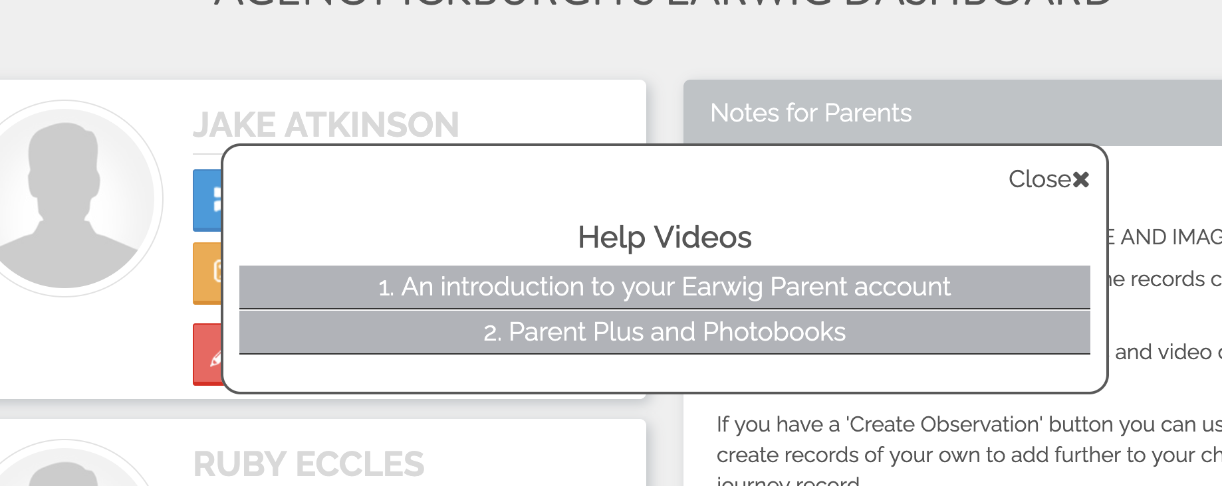
Earwig – website
Help:
13. You can check "How do I...?" to seek help on different areas of earwig

Slide 15
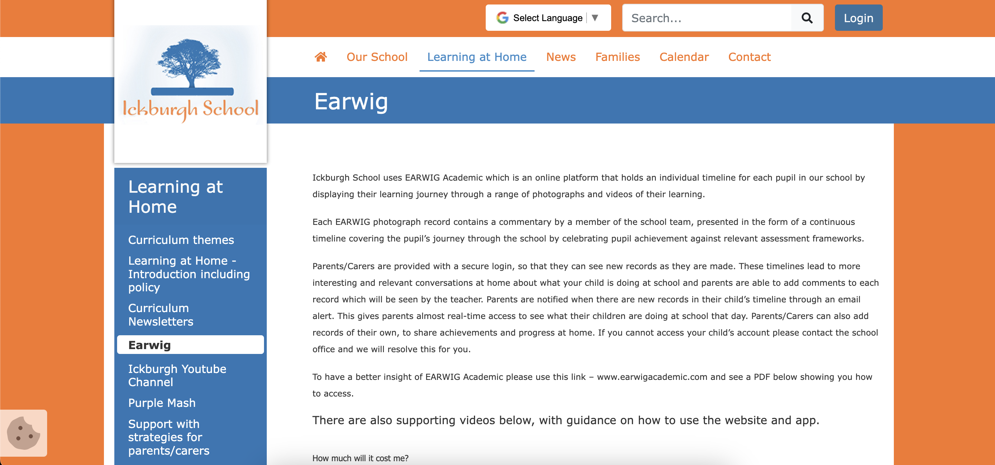
Earwig – help
Help:
14. Ickburgh website offers a page explaining how to use earwig and log in.
http://www.ickburgh.hackney.sch.uk/web/earwig_/477372

