Slide 1
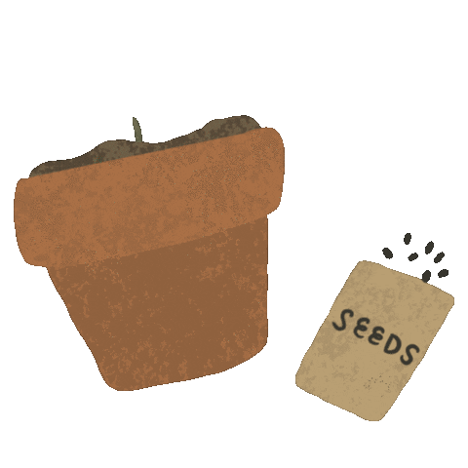
Adapted from the book Tiny seed by Eric Carle

Slide 2
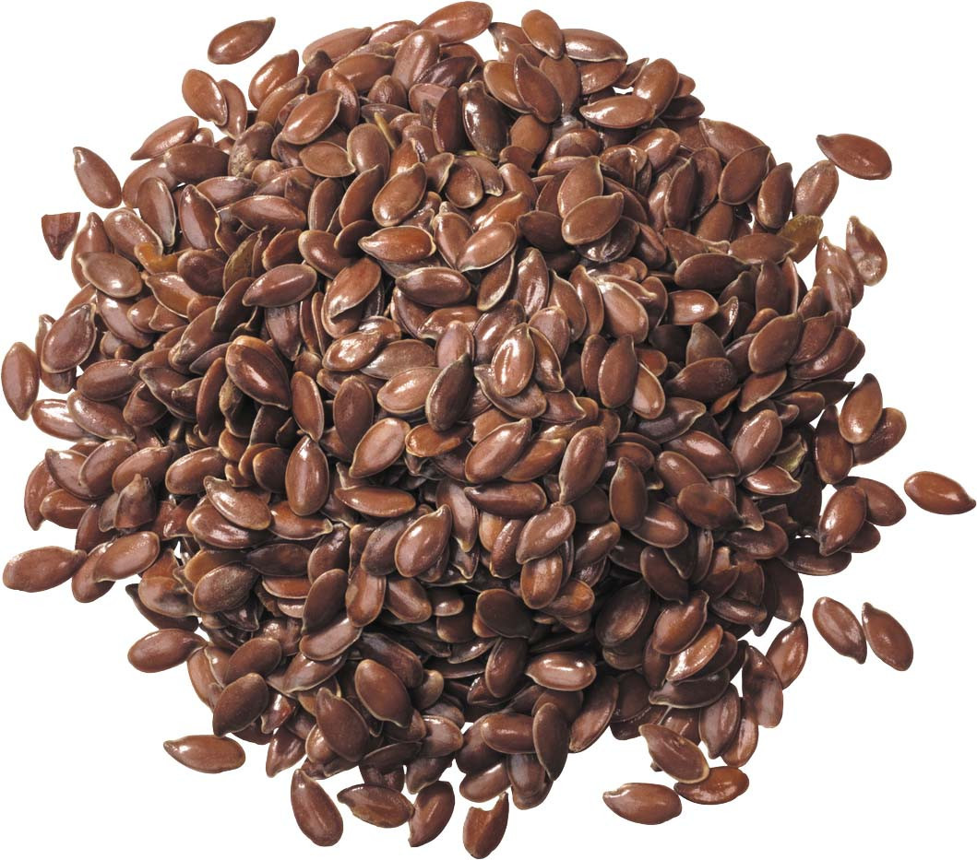
The wind blows seeds far across the land.
Actions: Blow the windmill or make wind using fans, switch toys. Play the wind sound.

Slide 3
One seed flies too high and the suns hot rays
burn it up. It doesn’t grow.
Actions: Feel the hot water (caution and safety) bottle. Shake head at 'it doesn't grow'.

Slide 4
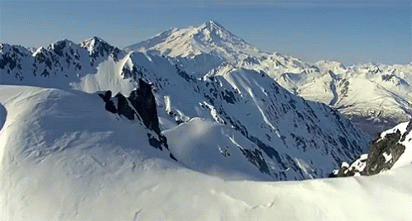
One seed lands on a cold icy mountain.
It doesn’t grow.
Actions: Feel a cold pack , or ice. Shake head.

Slide 5
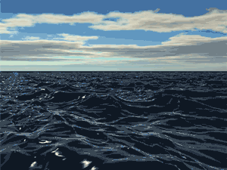
One seed falls into the ocean.
It doesn’t grow.
Actions. Feel water in tube. Play ocean sound. Shake head.

Slide 6
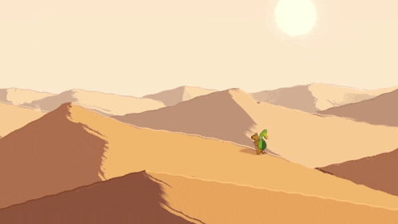
One seed lands on the hot, dry desert sand.
It doesn’t grow.
Actions :Feel the dry sand. Shake head.

Slide 7
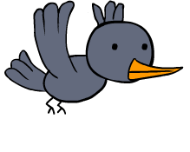
One seed is eaten by a bird
Feel the feathers/toy.
Play bird sound. Shake head.
It doesn’t grow.

Slide 8
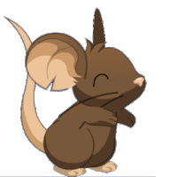
One seed is taken by a mouse.
Actions: Feel the grey mouse. Play mouse sound. Shake head.
It doesn’t grow.

Slide 9
Now it is spring.
It doesn’t grow.

Slide 10
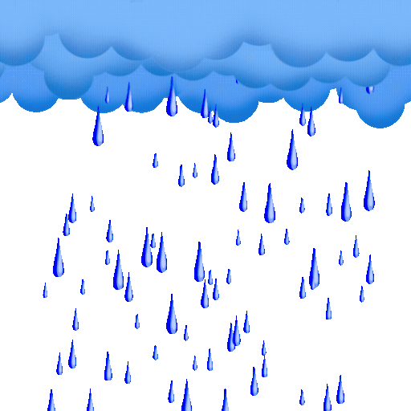
The weather is warm, the sun shines and rain falls.
Actions: Shine the torch light .Pour the water into a tube. Play rain sound.

Slide 11
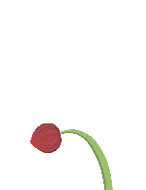
The tiny seed grows green leaves and a big beautiful flower.
Actions: Smell the flower. Feel the green leaves.

